Slide 1
Apply and Pivot Operators
User Defined Functions (UDF)
Scalar and Table-Valued Functions
Calling UDF from within SPROC

Slide 2
Table Operations: Basic versus Advanced
Joins – SQL Standard Table Operation
Basic: Inner, Left, Right, Full, Cross
Advanced: Composite, Non-Equi
T-SQL Extensions
Apply - For UDFs and other operations where Join will not work
Pivot and Unpivot - Converting Rows to columns with or without aggregating, and converting back the other way.

Slide 3
Programmable SQL statements: Basic and Advanced
Stored Procedures (SPROCS)
User Defined Functions (UDFs)
Scalar, Table valued
Exec(@SQL), sp_executeSQL

Slide 4
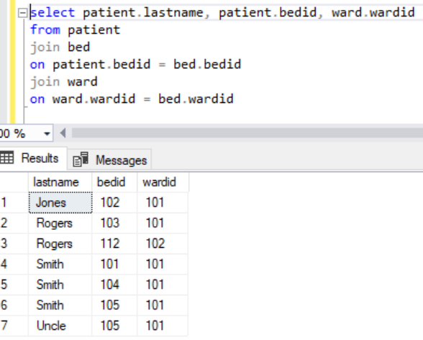
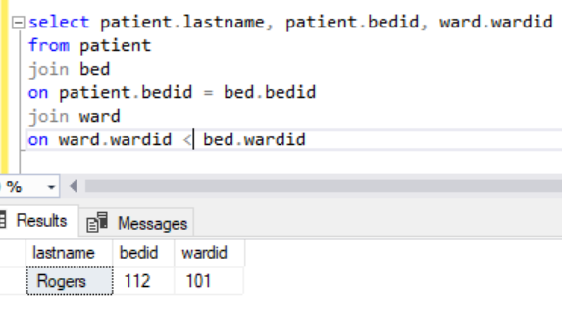
Joins
Composite Join
2 ‘on’ conditions
Non-equi Join
Non equal “on” condition
select p2.Name, ppc.ProductCategoryID
from production.Product as p2
join production.productcategory as ppc
on p2.rowguid = ppc.rowguid
and p2.ModifiedDate = ppc.ModifiedDate

Slide 5
Pivot and Unpivot
Pivoting - rotates rows to columns, with or without aggregating.
Unpivoting - rotates columns to rows, usually converting from an imported excel sheet.

Slide 6
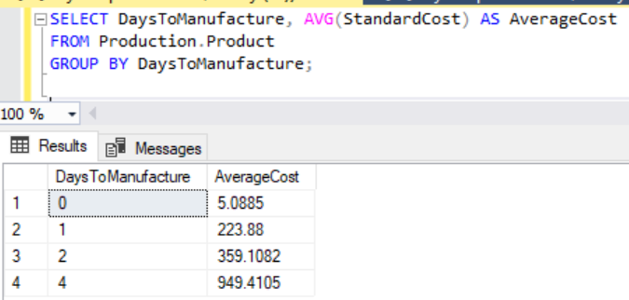
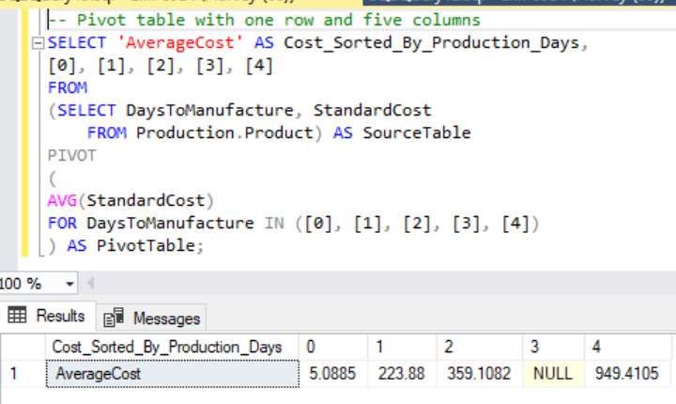
Pivot Example with AdventureWorks

Slide 7
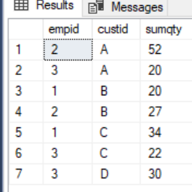
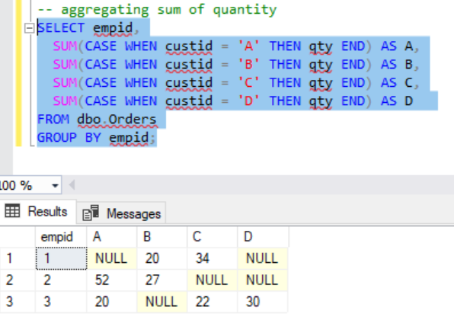
Pivoting Using Case Expression

Slide 8
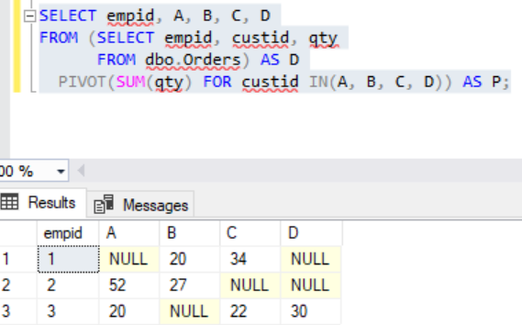
Pivoting Using Pivot Operator
SELECT empid, A, B, C, D
FROM (SELECT empid, custid, qty
FROM dbo.Orders) AS D
PIVOT(SUM(qty) FOR custid IN(A, B, C, D)) AS P;

Slide 9
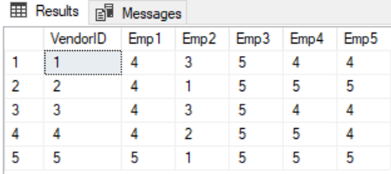
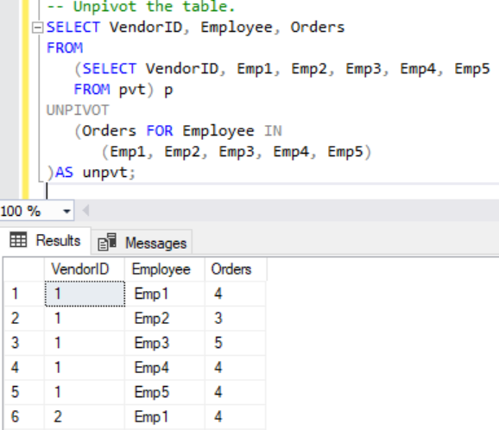
Unpivoting Example with AdventureWorks
https://docs.microsoft.com/en-us/sql/t-sql/queries/from-using-pivot-and-unpivot?view=sql-server-2017

Slide 10
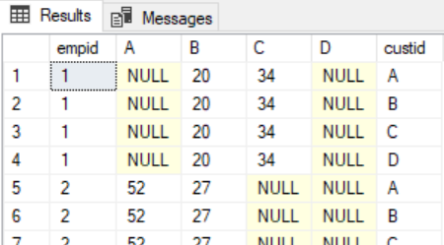
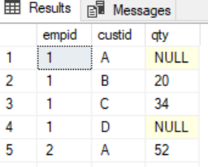
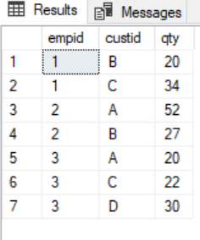
Unpivoting using Cross Join and Apply
-- Unpivot Step 1: generate copies
SELECT *
FROM dbo.EmpCustOrders
CROSS JOIN (VALUES('A'),('B'),('C'),('D')) AS C(custid);
-- Unpivot Step 2: extract elements
SELECT empid, custid, qty
FROM dbo.EmpCustOrders
CROSS APPLY (VALUES('A', A),('B', B),('C', C),('D', D)) AS C(custid, qty);
-- Unpivot Step 3: eliminate NULLs
SELECT empid, custid, qty
FROM dbo.EmpCustOrders
CROSS APPLY (VALUES('A', A),('B', B),('C', C),('D', D)) AS C(custid, qty)
WHERE qty IS NOT NULL;

Slide 11
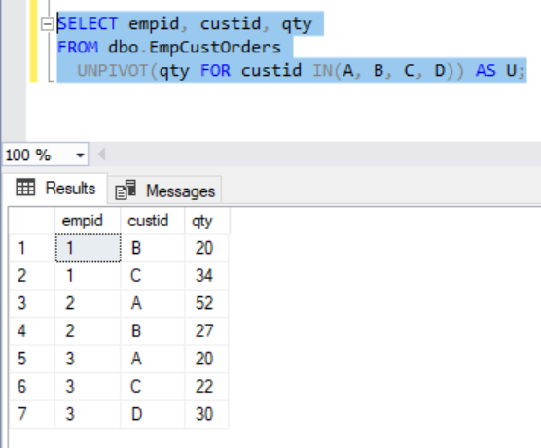
Unpivoting with Unpivot Operator
SELECT empid, custid, qty
FROM dbo.EmpCustOrders
UNPIVOT(qty FOR custid IN(A, B, C, D)) AS U;

Slide 12
User Defined Functions (UDF) User of system can create programmable functions
Scalar Function
Accepts an input variable and returns a single value.
Table Valued Function
Accepts an input variable and returns a table of values (columns, aggregates).
Compare with SPROC and CTE
Function can be called from within a select or a SPROC.
A SPROC is an entire select procedure itself.
A CTE is a subquery that only exists inside an outer query (or inside a UDF/SPROC).
https://docs.microsoft.com/en-us/sql/relational-databases/user-defined-functions/create-user-defined-functions-database-engine?view=sql-server-2017

Slide 13
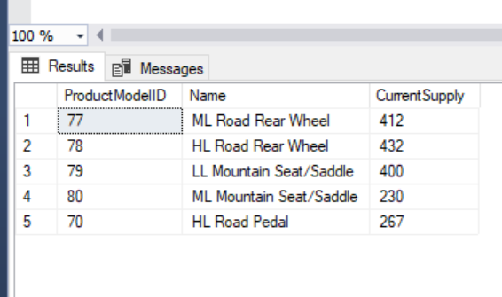
Scalar Example
CREATE FUNCTION dbo.ufnGetInventoryStock(@ProductID int)
RETURNS int
AS
-- Returns the stock level for the product.
BEGIN
DECLARE @ret int;
SELECT @ret = SUM(p.Quantity)
FROM Production.ProductInventory p
WHERE p.ProductID = @ProductID
AND p.LocationID = '6';
IF (@ret IS NULL)
SET @ret = 0;
RETURN @ret;
END;
SELECT ProductModelID, Name, dbo.ufnGetInventoryStock(ProductID)AS CurrentSupply
FROM Production.Product
WHERE ProductModelID BETWEEN 70 and 80;

Slide 14
Table Valued Example
CREATE FUNCTION Sales.ufn_SalesByStore (@storeid int)
RETURNS TABLE
AS
RETURN
(
SELECT P.ProductID, P.Name, SUM(SD.LineTotal) AS 'Total'
FROM Production.Product AS P
JOIN Sales.SalesOrderDetail AS SD
ON SD.ProductID = P.ProductID
JOIN Sales.SalesOrderHeader AS SH
ON SH.SalesOrderID = SD.SalesOrderID
JOIN Sales.Customer AS C
ON SH.CustomerID = C.CustomerID
WHERE C.StoreID = @storeid
GROUP BY P.ProductID, P.Name
);

Slide 15
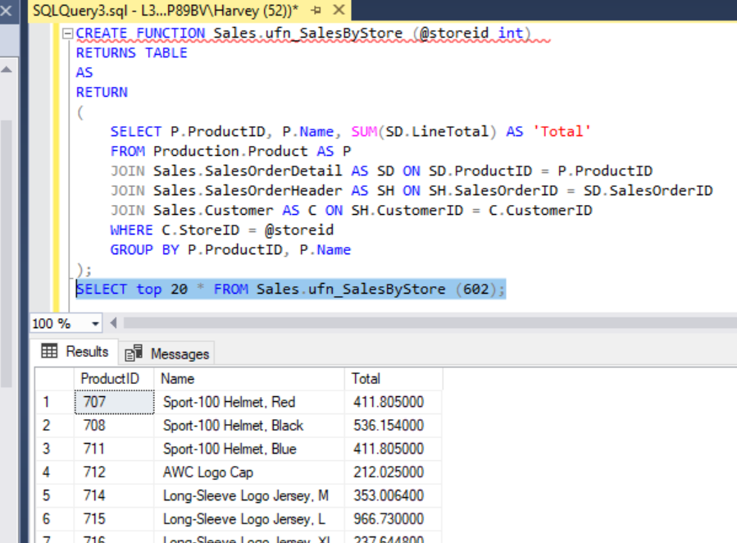
Functions are called in Select or SPROC You don’t Execute a Function

Slide 16
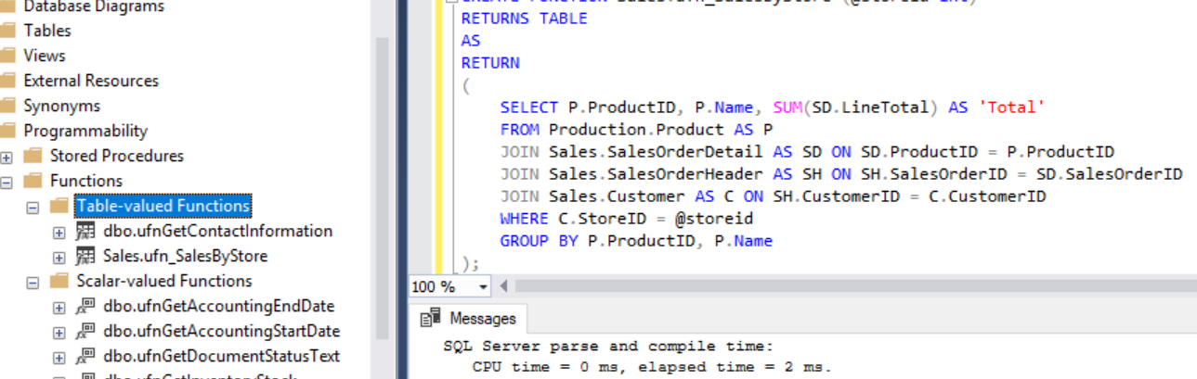
Locate Functions in Object Navigation Folder

Slide 17
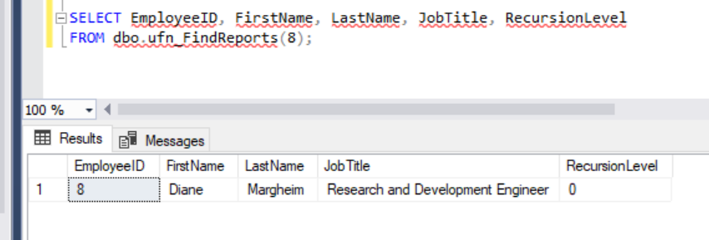
Select from Function as table result set

Slide 18
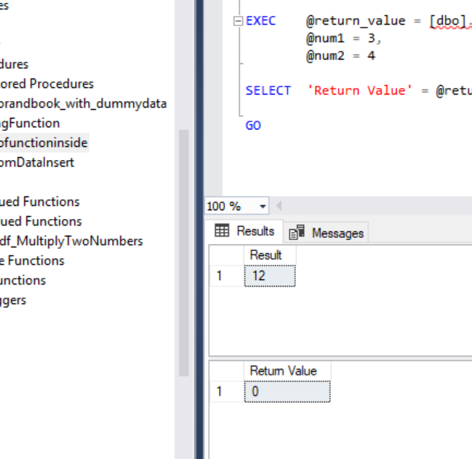
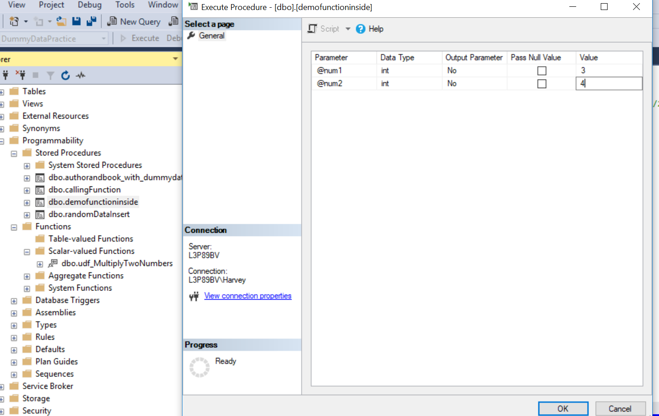
Simple Practice Example: Calling UDF from SPROC
Always associate with a schema
Create proc dbo.demofunctioninside @num1 int, @num2 int
as
begin
select dbo.udf_MultiplyTwoNumbers (@num1, @num2) as 'Result'
end
Create FUNCTION dbo.udf_MultiplyTwoNumbers
(
@Num1 int,
@Num2 int
)
RETURNS int
AS
BEGIN
DECLARE @Result int
SELECT @Result = @Num1 * @Num2;
RETURN @Result
END

Slide 19
Function with CTE and INSERT result to Table
CREATE FUNCTION dbo.ufn_FindReports (@InEmpID INTEGER)
RETURNS @retFindReports TABLE
(
EmployeeID int primary key NOT NULL,
FirstName nvarchar(255) NOT NULL,
LastName nvarchar(255) NOT NULL,
JobTitle nvarchar(50) NOT NULL,
RecursionLevel int NOT NULL
)
--Returns a result set that lists all the employees who report to the
--specific employee directly or indirectly.*/
AS
BEGIN
WITH EMP_cte(EmployeeID, OrganizationNode, FirstName, LastName, JobTitle, RecursionLevel) -- CTE name and columns
AS (
SELECT e.BusinessEntityID, e.OrganizationNode, p.FirstName, p.LastName, e.JobTitle, 0 -- Get the initial list of Employees for Manager n
FROM HumanResources.Employee e
JOIN Person.Person p
ON p.BusinessEntityID = e.BusinessEntityID
WHERE e.BusinessEntityID = @InEmpID
UNION ALL
SELECT e.BusinessEntityID, e.OrganizationNode, p.FirstName, p.LastName, e.JobTitle, RecursionLevel + 1 -- Join recursive member to anchor
FROM HumanResources.Employee e
JOIN EMP_cte
ON e.OrganizationNode.GetAncestor(1) = EMP_cte.OrganizationNode
JOIN Person.Person p
ON p.BusinessEntityID = e.BusinessEntityID
)
-- copy the required columns to the result of the function
INSERT @retFindReports
SELECT EmployeeID, FirstName, LastName, JobTitle, RecursionLevel
FROM EMP_cte
RETURN
END;

Slide 20
Apply versus Join
Cross APPLY
Similar to INNER JOIN. Retrieves records from the table valued function and the table being joined with matching rows.
Outer APPLY
Similar to FULL JOIN. Retrieves all records from both the table valued function and the table regardless of row match.

Slide 21
Apply versus Join
Apply is how we join a UDF table valued result with a Table
https://docs.microsoft.com/en-us/sql/t-sql/queries/from-transact-sql?view=sql-server-2017#using-apply
SQL Shack Walkthrough Example
https://www.sqlshack.com/the-difference-between-cross-apply-and-outer-apply-in-sql-server/

Slide 22
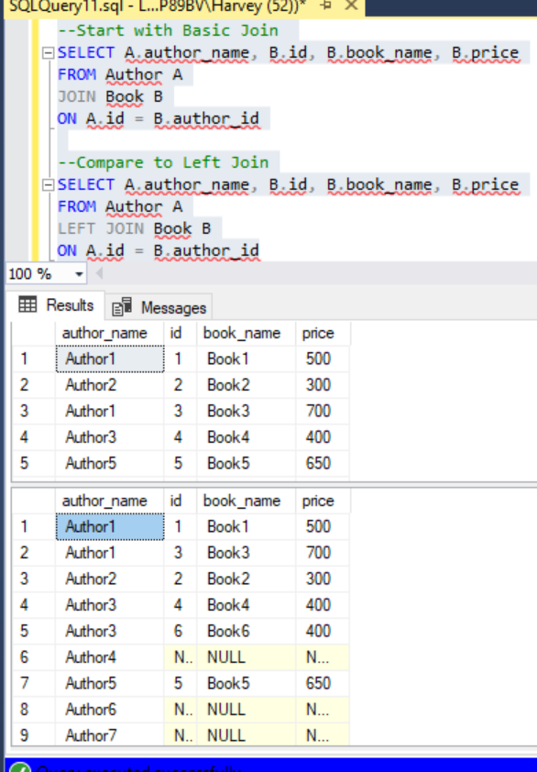
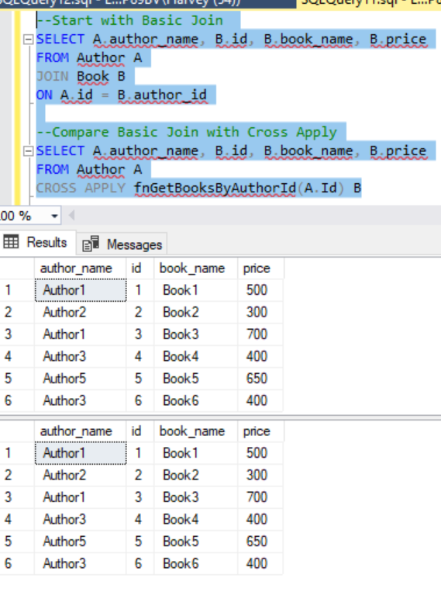
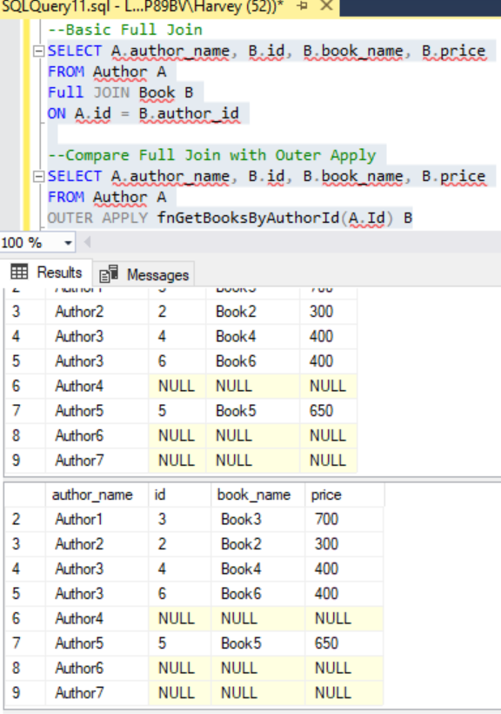
Join vs Apply Syntax Comparison using Library Sample DB

Slide 23
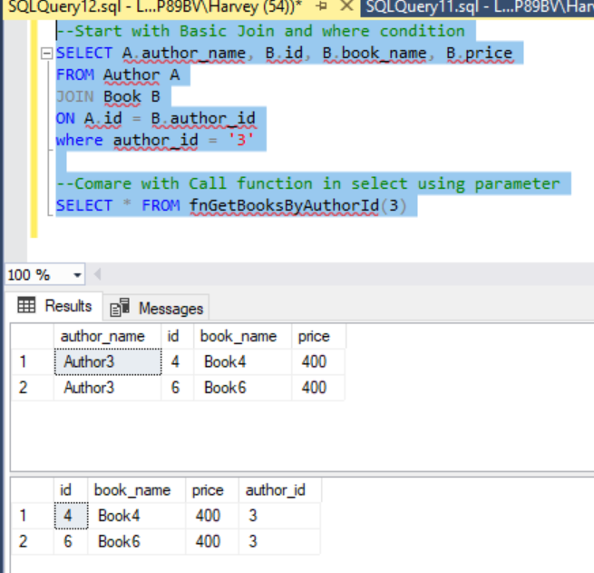
Join using Where condition versus UDF with Parameter
Greater flexibility in your search
This will come up again when we discuss SQL Injection.

Slide 24
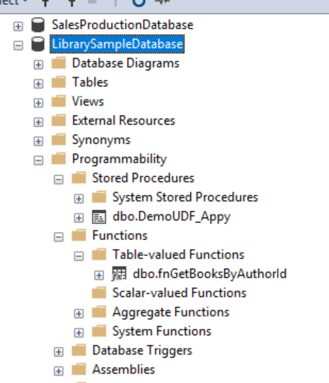
Apply and UDF Skill Exercises
1. Create a UDF scalar
2. Create a UDF Table Valued
3. Call function from select statement
Must have at least 1 parameter.
4. Create a SPROC that Calls UDF, Execute SPROC
Must have at least 2 parameters.
5. Produce Select statement result using Apply operator
Must have at least 1 UDF and 1 Table.
Must demonstrate 1 outer and 1 cross.
Compare to inner, left, full join
6. Demonstrate use of Intersect and Except Operators

Slide 25
Join Exercise
Run a series that demonstrates the following:
Cross Join
Composite Join
Non-equi Join
Must support a user story.

Slide 26
Pivot Exercise
Create a pivot table from a current table.
Unpivot the table to a new table.
Must support a user story and reporting requirement.

